Slide 1

TLP:AMBER
Module Two · Threat reports with no named element
Contextualized Threat Modeling
Dozens of credible campaigns against satellite operators are on record. None names the part of the Kestrel platform it would be written against.
Credible intelligence that names no element never becomes defensive work. This is the function that names the element.
Full Spectrum Space Cybersecurity Professional | Course slides | 34 minutes
Notes:
Open on the room, not the framework. Tuesday morning, an analyst with a list she can defend, an engineer asking a fair question, and nothing in between them. Then say what this module is: the function that turns a report into work for a named part of the platform. Two minutes.

Slide 2
TLP:AMBER
00
This module
What we will learn, and how
Anchor 1 threat to exactly 1 element, and record why 1 report was excluded
The gate a report must pass, the 6 fields of a record, and the 1 element it targets
Write 1 threat entry against its element, and 2 exclusions with their reasons
Notes:
Read the three lines as written. They are the objectives: what they will be able to do, what the module covers, and what they will produce. Say no timings and no logistics aloud; those are below, for you. Ten seconds.
RUN OF SHOW, for you and not for them: Slides 2 to 22, 17 minutes. Stop and ask at slide 4, the report, and slide 19, MISP. Then the classroom, 16 minutes: workbook Chapters 3 and 4, questions 1, 4, 7, the Day 2 minutes.

Slide 3
TLP:AMBER
01
Section one
The challenge
One report, three departments, and no element any of them can name.
Dozens of open-source items, and why most did not enter.
Three questions on the cost of a report that names no element.
Notes:
Eight seconds. Read the title and the three lines, then move.

Slide 4
The challenge
TLP:AMBER
A threat that names no element cannot be assigned
Threat report, external source · Kestrel platform, scope undetermined · Security Operations Center
WHAT EACH SOURCE COVERS
The KA-SAT case of February 2022: an actor reached the management network, abused the provider to customer trust relationship, and pushed a modem update that disabled tens of thousands of terminals across Europe.
Kestrel does not fly those modems, so the specific exploit does not transfer. The report is not disputed. No element of the Kestrel platform is named in it, so no task, signature or measure can be written against it.
The public KA-SAT reporting
What an actor did to another operator.
Not which part of Kestrel it touches.
MITRE ATT&CK
The behavior, named and numbered.
Not the element the behavior lands on.
SPARTA
The technique, scoped to space systems.
Not which Kestrel element the technique requires.
WHAT NONE OF THEM STATES
All three are true. None names an element, so none can be assigned, detected or measured.
Discuss: can you name the element a new threat report would be written against?
Module Two | Contextualized Threat Modeling
Notes:
RUN THIS ONE. Rung: RECOGNITION. Allow 2 minutes.
Ask it and wait. The room must see its own week in the problem before anything after this lands.
WHY THE ROOM STALLS, and it is not incompetence. Every source on that desk is correct and current. The KA-SAT reporting is public and well evidenced. ATT&CK names the behavior precisely. SPARTA scopes the technique to space systems. All three describe the adversary, and none of them can name a part of Kestrel, because none of them knows Kestrel exists.
THE ANSWER DANA GETS IS THE TEACHING. The modem was never the target. The trust relationship was, and Kestrel has the same relationship: a patch pipeline trusted by everything downstream of it. Once somebody says that out loud the report has a target, and the target is an element the room enumerated yesterday.
STOP AND ASK. Ask the question and wait. Somebody will describe their own version of this, which is the point.
SAY THE CLAIM EXACTLY RIGHT. Nobody in this story did anything wrong and nothing on the desk is out of date. The gap is that no framework on that desk lets an operator write down which element a report is about. That is narrow and it survives contact with the people who wrote those documents.
LISTEN FOR: that an unanchored report produces no task, no signature and no measure, whatever its quality
If the room does not get there, say it, then move on. Do not argue it.
Register: SP-02, in METEORSTORM-Selling-Points.md.
IN THE ROOM'S OWN RECORD
Workbook Module 02 workbook, Chapter 1, The Day in One Page
Question Module 02 question set, Q1
Minutes Day 2 minutes, item 02, What counts as a threat we can act on

Slide 5
The challenge, and who carries it
TLP:AMBER
Three readings, and none names an element
Each department states something true about the same case that the other two cannot state.
1
Security Operations: the campaign
2
Satellite Operations: the link
An actor, a technique, a citation. Defensible, and not placed on this platform.
Requires one element to watch on a continuous link. A campaign name supplies none.
3
Design and Engineering: the build
States that the modem differs, not which Kestrel element performs the same function.
Discuss: which of the three readings names an element, and which one must be asked for it?
Module Two | Contextualized Threat Modeling
Notes:
Three reads, three departments, one report. Dana asked in the minutes why all three had to sit through it rather than Security Operations writing the catalogue and circulating it. The answer is worked rather than asserted: intelligence names the behavior, operations knows what the platform does under load, engineering knows what is actually built. A threat none of the three can corroborate is not ready to enter.
That is slower than one analyst writing alone, and it is the reason each entry survives challenge.
LISTEN FOR: that naming the element is the missing step, and it happens today only when somebody asks
If the room does not get there, say it, then move on. Do not argue it.
Register: SP-02, in METEORSTORM-Selling-Points.md.
IN THE ROOM'S OWN RECORD
Workbook Module 02 workbook, Chapter 1, The Day in One Page
Question Module 02 question set, Q1
Minutes Day 2 minutes, item 01, How the day was going to be run

Slide 6
The cost
TLP:AMBER
Dozens in, four out, and every exclusion has a reason
The open-source list was re-sorted against the gate. Most items did not enter, and none was discarded.
WHAT ARRIVED
WHY IT DID NOT ENTER
WHERE IT WENT
Campaigns against payload ground systems
Targets a part this pass has not enumerated
Held in the open-source register
Advisories for products Kestrel does not fly
No element on this platform to name
Held, re-checked when the model grows
Actor profiles with no named behavior
Nothing it would act on
Cited as background reading
THE RULE
Nothing was discarded. Every exclusion carries its reason, which is the argument for widening the scope next round.
Discuss: can an excluded report be produced later with the reason it was excluded?
Module Two | Contextualized Threat Modeling
Notes:
THIS IS THE SLIDE THAT STOPS THE DECK LOOKING DISHONEST. A room shown four threats will ask whether four is the whole landscape. Answer it here rather than at the catalogue.
Theo's condition from the minutes is the rule on the slide: record what was left out. A threat with no target stays out until either the target is decomposed or the threat is scoped out. It is a queue, not a bin, and the queue is what justifies the budget for the next pass.
Do not read the rows. Point at the third column and say that nothing in it was deleted.
LISTEN FOR: that a short catalogue is only defensible when the exclusions are written down with their reasons
If the room does not get there, say it, then move on. Do not argue it.
Register: SP-03, in METEORSTORM-Selling-Points.md.
IN THE ROOM'S OWN RECORD
Workbook Module 02 workbook, Chapter 3, The Gate
Question Module 02 question set, Q4
Minutes Day 2 minutes, item 02, What counts as a threat we can act on
YOU WILL HEAR THIS
Who Theo Lindgren, Satellite Operations
Objection He agreed to the small first pass only on the condition that the room records what was left out, so nobody later reads a short catalogue as a claim that the platform faces four threats.
Answer Accepted as written. Everything not enumerated is held in the open-source register with the reason recorded, and it enters when its elements do.
Condition The register is the argument for widening the scope in the next pass, not a bin.
Record Day 2 minutes, item 01 and item 02

Slide 7
Discuss
TLP:AMBER
Three questions on the challenge
METEORSTORM anchors a threat report to one enumerated element, so credible reporting becomes work for a named part of the platform.
1
Do you have that capability now?
A threat that names no element is recorded as excluded with its reason, so a short catalogue is never mistaken for a small threat landscape.
2
Can you produce that record today, or is the excluded item discarded?
Naturally occurring threats are enumerated against the same elements as adversarial ones, so a jamming campaign and a solar event meet on one record.
3
Can your team do that with what you hold today?
Module Two | Contextualized Threat Modeling
Notes:
Three questions, three claims, and the claim is the sales point. Read the claim, ask the question, then WAIT. The silence is the teaching. Take two answers per question and move on; past three the room stops answering and starts waiting.
The draw lines are what to steer to after they have spoken, never before.
Register: SP-02, in METEORSTORM-Selling-Points.md.
WHAT TO STEER TO, AFTER THEY HAVE SPOKEN
1. If the answer drifts, steer it to: today the anchoring happens in somebody's head, in a meeting, if the right person is in the room.
2. If the answer drifts, steer it to: the exclusions are the scope argument for next quarter. Discarding them discards the evidence for the budget.
3. If the answer drifts, steer it to: two catalogues that never meet, and an operator deciding at 03:10 which one tonight belongs to.

Slide 8
TLP:AMBER
02
Section two
What METEORSTORM brings
The gate that turns a report into an entry, or keeps it out on the record.
Three published environments with no elements yet, and threats already writable.
Six fields, and why TARGET holds exactly one element.
Notes:
Eight seconds. This is the section that sells the framework rather than reprinting the workbook.

Slide 9
The turn
TLP:AMBER
A threat with no enumerated target is not in the catalogue
A report lands. One question decides whether it becomes work or becomes a reading list.
Intelligence
An actor with no element it would act on. Real, cited, and not yet a threat you can work.
Name the element
A credible threat report arrives
One enumerated platform element, at the lowest layer the source resolves.
An enumerated threat
It names its target element, so the three later functions inherit that anchor.
Discuss: can you produce a threat register where every entry names the element it targets?
Module Two | Contextualized Threat Modeling
Notes:
WHAT CHANGES FOR MAYA. Before the gate, her list is ranked by how convincing the reporting is. After it, it is ranked by which part of this platform the report is about, and that is a list three departments can divide between themselves without a meeting.
Quote the gate verbatim from Chapter 3: if it names an actor with no element it would act on, it is intelligence, not an enumerated threat, name the target or leave it out.
Then say the part that makes it honest rather than dismissive, because a room hears a gate as a way of saying no. A threat with no target stays out until either the target is decomposed or the threat is scoped out. It is a queue, and the previous slide showed where the queue lives.
LISTEN FOR: that the gate is what makes a catalogue reviewable, because every entry and every exclusion carries a reason
If the room does not get there, say it, then move on. Do not argue it.
Register: SP-03, in METEORSTORM-Selling-Points.md.
IN THE ROOM'S OWN RECORD
Workbook Module 02 workbook, Chapter 3, The Gate
Question Module 02 question set, Q4
Minutes Day 2 minutes, item 02, What counts as a threat we can act on

Slide 10
The future proof
TLP:AMBER
A threat can be written against a domain you do not run
Satellite Operations asked this after a quarterly business review. The answer is three published tags.
IF THE BUSINESS ADDS
THE THREAT ANCHORS INTO
WHAT CHANGES IN THE MODEL
A maritime ground network
PCE-AQ · aquatic segment
Nothing. A new parent, no renumbering.
An uncrewed aerial relay
PCE-AE · low, high, near space
Nothing. It names the segments it crosses.
A deep space leg
PCE-DS · its own segment
Nothing. Light time belongs to the environment.
THE RULE
Three of the five published environments carry no Kestrel elements today. A threat against them is writable now.
Discuss: can you anchor a threat to a maritime or aerial asset without redesigning the model?
Module Two | Contextualized Threat Modeling
Notes:
THIS IS THE FUTURE PROOF AND IT IS A SALES SLIDE, so do not read the table. Module 1 showed the five environments; this slide answers the question that follows, which is what happens to the THREAT CATALOGUE when the business changes shape.
ONE. The three unused environments are published in the taxonomy, openly, and were not added for this platform. A threat against a maritime ground network can be written today, before the first site exists, because its parent exists.
TWO. Because ordinals are issued once and never renumbered, adding an environment changes nothing written this week. Every entry in this catalogue survives the company becoming something other than a satellite operator.
THREE. Say the alternative out loud, because it is what the buyer is weighing: a model built for satellites needs a schema project before the first threat against a new domain can be written down at all.
That is the answer to the buyer asking what happens when the business changes shape.
LISTEN FOR: that the three unused environments are why a threat against a domain you have not entered is already writable
If the room does not get there, say it, then move on. Do not argue it.
Register: SP-01, in METEORSTORM-Selling-Points.md.
IN THE ROOM'S OWN RECORD
Workbook Module 02 workbook, Chapter 2, The Analytic Layer
Question Module 02 question set, Q2
Minutes Day 1 minutes, item 03, What happens when the company is not only a satellite operator
YOU WILL HEAR THIS
Who Theo Lindgren, Satellite Operations
Objection He asked, after a quarterly business review, whether the room was about to standardize on a model that only describes satellites.
Answer The taxonomy publishes five environments and Kestrel populates two. A threat against an aquatic or aerial asset anchors into a parent that already exists.
Condition Nothing enumerated this week is renumbered when a new environment is populated.
Record Day 1 minutes, item 03

Slide 11
The record
TLP:AMBER
Six fields. TARGET holds exactly one element.
Two of the four Kestrel threats. TARGET, the TOE, is the one element the threat is aimed at.
THREAT · ORDINAL 00
THREAT · ORDINAL 02
Ground management plane
Radio-frequency jamming
The key below: the layer AN, then TAG, LABEL and ORDINAL.
The same fields. Its target sits one layer lower.
TAG
THR
TAG
THR
LABEL
Threat
LABEL
Threat
ORDINAL
00
ORDINAL
02
SOURCE
observable
SOURCE
observable
TARGET · TOE
SVC:CP:Control Plane:09
TARGET · TOE
AST:SI:Signal:00
DESCRIPTION
actor, capability, citation
DESCRIPTION
actor, capability, citation
the four-field key, the identifier without its description
the four-field key, the identifier without its description
AN:THR:Threat:00
AN:THR:Threat:02
Discuss: can you hand a partner a threat record they can act on without a phone call?
Module Two | Contextualized Threat Modeling
Notes:
THIS IS THE EASE ARGUMENT, which is what a buyer is actually weighing. Two of the six fields are fixed by the taxonomy, one is a two-digit number, one is a declared source, one is a platform element already named yesterday, and the last is a sentence somebody writes.
Read the target field out loud both times, because the sales point is in the difference: one threat resolves to a service, the other to an asset, and neither was rounded to a convenient layer. The rule as published is concrete, not broad, at the lowest layer the source resolves.
WHY EXACTLY ONE, in the workbook's own words: a target field with four elements in it cannot tell a reader which one the finding is actually about. Everything else the threat touches goes in the description, where it belongs.
LISTEN FOR: that six fields is a low price for a threat all three departments act on without translating it
If the room does not get there, say it, then move on. Do not argue it.
Register: SP-03, in METEORSTORM-Selling-Points.md.
IN THE ROOM'S OWN RECORD
Workbook Module 02 workbook, Chapter 4, The Catalogue
Question Module 02 question set, Q7

Slide 12
Discuss
TLP:AMBER
Three questions on what it brings
The aquatic environment is published with an aquatic segment beneath it, so a first maritime ground network is an enumeration and not a schema change.
1
Can you do that today without redesigning the model?
A threat record carries its target as an identifier a partner resolves, not as a sentence describing the affected system.
2
Do you have that capability now?
Every threat names one element, so one query returns every threat against a control plane service, across every department that wrote one.
3
Can your team do that with the catalogue you keep today?
Module Two | Contextualized Threat Modeling
Notes:
Read the claim, ask the question, wait. These three are the sale: the model already carries the domains the business has not entered, the record travels without translation, and the catalogue answers a query rather than being read.
Take two answers each and move.
Register: SP-03, in METEORSTORM-Selling-Points.md.
WHAT TO STEER TO, AFTER THEY HAVE SPOKEN
1. If the answer drifts, steer it to: the alternative is a schema project before the first threat against the new domain can be written down at all.
2. If the answer drifts, steer it to: describe the affected system is a dispute in a contract. A named target of exploitation is a clause.
3. If the answer drifts, steer it to: anchoring is what makes a catalogue queryable. An unanchored catalogue can only be read end to end.

Slide 13
TLP:AMBER
03
Section three
In the room
Seven decisions taken on Tuesday, and the gate agreed before the evidence.
The objection from Satellite Operations, and the element that answered it.
Three rulings, three named owners, and one ordinal that is never renumbered.
Notes:
Eight seconds. Say what this section is: the Day 2 minutes are a record of three departments arguing, and every objection in them is one this room will hear. The minutes ship as a handout beside the workbook and the question set.

Slide 14
In the room · the proposal
TLP:AMBER
The gate was agreed before any evidence was opened
Tuesday 04 August. Reston conference room 2, Kiruna on the link. The rule chose the set, not the other way round.
Agree the method, then open the evidence
One working day. A threat enters only if it names exactly one element enumerated on Monday.
Security Operations
Satellite Operations
Design and Engineering
Brought dozens of defensible open-source campaigns, and the objection that one day loses most of them.
Agreed to the small set on the condition that what was left out is recorded.
Asked why three departments had to sit through it rather than one writing the catalogue.
Discuss: can a method be agreed before the evidence is opened, in a room that wants to start?
Module Two | Contextualized Threat Modeling
Notes:
Set the scene in two sentences and no more. Tuesday morning, a one day constraint named at the start rather than discovered at 16:00, and a lead who asks the room to agree the method first and let the method decide the size of the set.
The teaching is the order. The rule chose the set. Had the evidence been opened first, the catalogue would have been whatever Maya could argue hardest for, and Dana would have been right to distrust it.
Maya's pushback is worth quoting because it is fair: her list is not lost, it is queued. What a day buys is a method that holds and a small set the next pass extends. What a quarter buys is a longer document nobody has used yet.
The minutes are a handout. Send the room to Day 2 rather than reading it to them.
LISTEN FOR: that agreeing the rule first is what stops the loudest report choosing the catalogue
If the room does not get there, say it, then move on. Do not argue it.
Register: SP-02, in METEORSTORM-Selling-Points.md.
IN THE ROOM'S OWN RECORD
Workbook Module 02 workbook, Chapter 1, The Day in One Page
Question Module 02 question set, Q1
Minutes Day 2 minutes, item 01, How the day was going to be run

Slide 15
In the room · the resistance
TLP:AMBER
The objection Satellite Operations raised
Threat 01 is misuse of valid command authority. His controllers are the people that describes, and he said so.
Not the person
The controller holding the authority is who the measure has to protect, not who it watches.
What is the threat actually against?
This reads as an accusation against my team
Asked of a telecommand issued with entirely valid credentials.
The authority
A model that cannot describe misuse of a valid credential cannot protect the operator who is impersonated.
Discuss: can a threat be written against an authority rather than against the people holding it?
Module Two | Contextualized Threat Modeling
Notes:
RUN THIS AS THE OBJECTION IT IS. Somebody in the room has a team that would react the same way, and hearing it named by a character is easier than raising it themselves.
The reframe is the whole teaching and it is one sentence: the threat is against the authority, not the person holding it. Say it slowly.
Then give the consequence, because it is what won Theo over: a model that cannot describe misuse of a valid credential cannot protect the operator who is impersonated. Without the entry, the controller who gets impersonated has nobody watching for it on their behalf.
HIS CONDITION IS CARRIED AND IT CLOSES ON FRIDAY. He accepted on the basis that the eventual control protects controllers rather than watching them, and on Day 5 the measure written against this threat is the one he asked for. Say that now, because a condition that never returns teaches the room that conditions are a formality.
LISTEN FOR: that naming the authority as the target is what turns an accusation into a control the operator wants
If the room does not get there, say it, then move on. Do not argue it.
Register: SP-02, in METEORSTORM-Selling-Points.md.
IN THE ROOM'S OWN RECORD
Workbook Module 02 workbook, Chapter 4, The Catalogue
Question Module 02 question set, Q9
Minutes Day 2 minutes, item 04, Threat 01, compromise of command authority
YOU WILL HEAR THIS
Who Theo Lindgren, Satellite Operations
Objection Threat 01 describes an adversary holding valid command authority and issuing unauthorized telecommands. His controllers are the people that sentence describes, and he said plainly that it reads as an accusation against his team.
Answer The threat is against the authority, not against the person holding it. A model that cannot describe misuse of a valid credential cannot protect the operator who is impersonated.
Condition The eventual control must be built so it protects controllers rather than watching them.
Record Day 2 minutes, item 04, and carried to Day 5

Slide 16
In the room · the ruling
TLP:AMBER
What settled it, who owns it, what was carried forward
A ruling names an owner. An ordinal issued once is never renumbered, whatever it would do to a tidy document.
THE RULING
OWNER
CARRIED FORWARD
Four threats pass the gate on the telecommand path
Security Operations Center
The rest held in the open-source register
Ordinals are register-issued and never renumbered
Security Operations Center
The gaps are the threats that failed the gate
Threat 01 targets the authority, not the operator
Satellite Operations
The recorded condition goes to the Day 5 measure
THE RULE
The gate every later function inherits: the target of exploitation names exactly one element enumerated on Day 1.
Discuss: can you show a reviewer why a threat was excluded, with the reason against it?
Module Two | Contextualized Threat Modeling
Notes:
Three rulings, three owners, three things carried forward. The pattern is the teaching, not the rows.
ROW TWO is the one to dwell on, because it looks like bureaucracy and is not. Theo asked why the four threats are not simply numbered one to four. The ordinals come from the Security Operations Center's running register, one sequence across every threat the organization tracks, not a per-project count. Renumbering to make a document look tidy would break every reference from this meeting onward, and the gaps are informative: they are the threats that did not pass the gate.
That single ruling is what lets the same number carry the scenario into the attack path, the signature and the measure. It is the mechanism behind the rail they are about to see.
Close the section on what Day 2 hands Day 3: a threat without a path is an assertion, and the same ordinal carries the work forward.
LISTEN FOR: that a recorded exclusion with a named owner is how a small first pass stays a choice rather than an oversight
If the room does not get there, say it, then move on. Do not argue it.
Register: SP-02, in METEORSTORM-Selling-Points.md.
IN THE ROOM'S OWN RECORD
Workbook Module 02 workbook, Chapter 4, The Catalogue
Question Module 02 question set, Q12
Minutes Day 2 minutes, decision register and actions
Mindset Pentagon of Pain, Chapter 3.2, The three departments and their seams

Slide 17
Discuss
TLP:AMBER
Three questions on the judgment
METEORSTORM writes the threat against the authority rather than the person holding it, so the resulting control protects the operator who gets impersonated.
1
Do you have that capability now?
An ordinal is issued once by the register and never renumbered, so the same number carries the scenario from threat to attack path to signature to measure.
2
Can you do that today across four separate documents?
A department's objection is recorded with an owner and a date it returns, so a condition attached on Tuesday is answerable on Friday.
3
Can your organization do that without a mandate behind it?
Module Two | Contextualized Threat Modeling
Notes:
These three are about organizational change rather than notation, which is what section three exists for. Read the claim, ask the question, wait.
Question three usually produces the most honest answer in the deck. Let it.
Register: SP-02, in METEORSTORM-Selling-Points.md.
WHAT TO STEER TO, AFTER THEY HAVE SPOKEN
1. Steer the room to: a model that cannot describe misuse of a valid credential leaves the impersonated controller with nobody watching for it.
2. Steer the room to: the gaps in the numbering are the threats that failed the gate, which is information a tidy renumbering destroys.
3. Steer the room to: this is the transformation, not the vocabulary. A department changes what it measures its own work by only when conditions come back.

Slide 18
TLP:AMBER
04
Section four
Real world tools
The threat as a MISP event, tagged meteorstorm:AN=AN-THR.
Its TOE and its source recorded as attributes, not prose.
The same entry resolving to its one target in Maltego.
Notes:
Eight seconds. Say that both slides are screenshots of the real tool, taken when this deck was built.

Slide 19
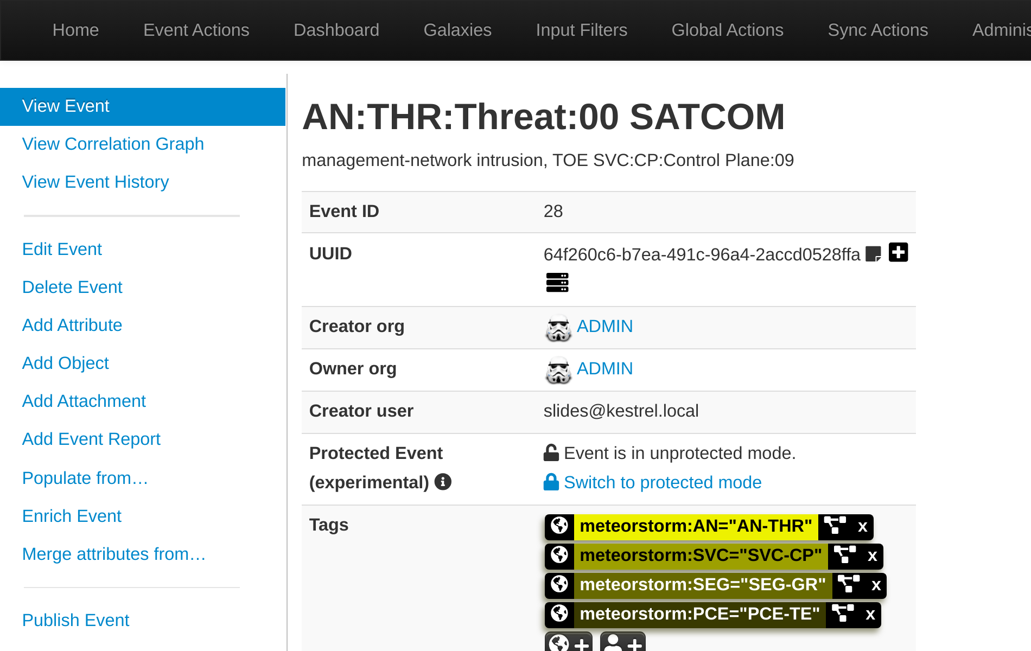
In the work center
TLP:AMBER
One event, tagged meteorstorm:AN=AN-THR
The analytic value is a tag. The target of exploitation is an attribute.
1
Tags: AN-THR, and the layers of the element it targets.
2
Attributes: the ETEN, the target of exploitation, the source.
3
Machine to machine, no vocabulary agreement needed first.
MISP 2.5.45, 2026-09-15. Event 28, AN:THR:Threat:00.
Discuss: are you allowed to run MISP here, and if not, could your platform take the taxonomy file?
Module Two | Contextualized Threat Modeling
Notes:
RUN THIS ONE. Rung: ADOPTION. Allow 2 minutes.
The objection belongs here, in the room, where it can be answered. Have the fallback ready.
STOP AND ASK. Take the answers and give the fallback: meteorstorm is a published MISP taxonomy file, so any platform reading MISP taxonomies takes it unchanged, and a platform that reads none still takes the five fields as a naming convention. Read the attributes aloud: AN:THR:Threat:00, TOE SVC:CP:Control Plane:09, SOURCE observable with the Viasat KA-SAT public reporting cited. Reproduce it: Taxonomies, Enable meteorstorm, then tag the event and add the three attributes.
LISTEN FOR: that the taxonomy is a file, so a platform that reads MISP taxonomies takes it unchanged and one that reads none still takes the five fields as a convention
If the room does not get there, say it, then move on. Do not argue it.
Register: SP-01b, in METEORSTORM-Selling-Points.md.

Slide 20
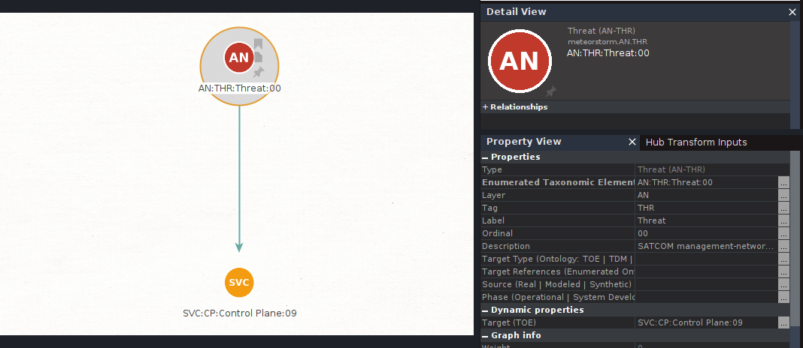
In the work center
TLP:AMBER
AN:THR:Threat:00 resolves to one element, not a set
One entity, one target link, one element. Target (TOE) is a property.
Maltego Graph 4.11.2 with the Maltego for Space pack, 2026-09-15. AN:THR:Threat:00 selected; graph and Property View from one screen.
Discuss: can a threat catalogue be queried by element today, or does somebody read it?
Module Two | Contextualized Threat Modeling
Notes:
Same record, second tool. The entity pack carries one entity per analytic value, so a threat is a typed node rather than a note. Point at the single outgoing link: the target field is the whole ontology of the analytic layer, and a threat with two targets is two threats.
LISTEN FOR: that anchoring is what makes the catalogue queryable, and an unanchored catalogue can only be read end to end
If the room does not get there, say it, then move on. Do not argue it.
Register: SP-03, in METEORSTORM-Selling-Points.md.

Slide 21
Discuss
TLP:AMBER
Three questions on adoption
The taxonomy is published openly as a MISP taxonomy file, so a partner's threat record arrives readable and there is no translation layer to build.
1
Do you have that capability now?
The analytic tag separates the threat from the path, the signature and the measure, so three people work the same scenario without overwriting each other.
2
Can your team do that in the tooling you already run?
The threat is one of the element types the Space Information Sharing and Analysis Center approves for sharing, so a confirmed entry can leave the building.
3
Can you do that today without a bilateral format agreement?
Module Two | Contextualized Threat Modeling
Notes:
The three questions on adoption. These are permission and capability questions and they are meant to be answered out loud with a yes, a no, or we would need approval.
The fallback matters more than the yes: a platform that reads no MISP taxonomies still takes the five fields as a naming convention. Nobody is asked to migrate.
Register: SP-01b, in METEORSTORM-Selling-Points.md.
WHAT TO STEER TO, AFTER THEY HAVE SPOKEN
1. If the answer drifts, steer it to: nothing has to be built if MISP is already running. It is a file, enabled in the Taxonomies screen.
2. If the answer drifts, steer it to: one query returns every threat that names a control plane service, whoever wrote it and whenever.
3. If the answer drifts, steer it to: the channel runs both ways. A threat arriving in the same vocabulary routes to whoever owns the element it names.

Slide 22
The chain
TLP:AMBER
Link two names an element that already exists
AN:THR:Threat:00 names SVC:CP:Control Plane:09 as its TOE. The three links after it inherit that element.
ELEMENT
THREAT
ATTACK PATH
DETECTION
RESILIENCE
One enumerated part of the platform, with its parents
Names that element as the thing it would attack
The route to it, and the sources each step needs
One signature per attack path, on that element, and its playbook
A measure on that element, against one goal
One element. One ordinal. Five links. Nothing else joins them.
Today produced link two. The threat named SVC:CP:Control Plane:09 as its target of exploitation, and the three links after it now inherit that element rather than choosing their own.
No data source is collected because it exists. It is required because one step of one path against this element cannot be seen.
Discuss: can a new threat inherit its environment and segment on creation, with no linking step?
Module Two | Contextualized Threat Modeling
Notes:
The room met this rail yesterday. Point at link one, say it was built in module one, and then at link two, which is today. The word that matters is NAMES: the threat names an element the inventory already contains, it does not invent a target or describe an affected system in a sentence. A threat that cannot name one is excluded on the record, which is the gate they saw earlier.
The anchor equality line is verbatim from page 8 of the analytic layer reference: the anchor equality is what makes coverage auditable. Say what it replaces, which is a cross-reference table maintained by hand, correct on the day it is written and wrong by the end of the week.
The amber line is the same sentence they heard yesterday and will hear three more times. It is worth repeating unchanged: nothing on this rail asks for more collection, and tomorrow they will see where the source list actually comes from.
LISTEN FOR: that a link is correct on the day it is written and wrong by Friday, while an inherited anchor cannot drift
If the room does not get there, say it, then move on. Do not argue it.
Register: SP-03, in METEORSTORM-Selling-Points.md.

Slide 23
TLP:AMBER
05
Section five
The classroom
Workbook Chapters 3 and 4: 2 exclusion reasons, then 1 threat on 1 element
Question set: questions 1, 4 and 7, each answer given with its reason
Day 2 minutes, items 01, 02 and 04: the rule agreed first, the objection
Notes:
Slides down. Say the three pieces in order and open the first one. The timings and how answers are taken are yours, not theirs: three minutes on the exercise, then two answers and the key; the questions by show of hands. The exact sentences are in the instructor guide.

Slide 24
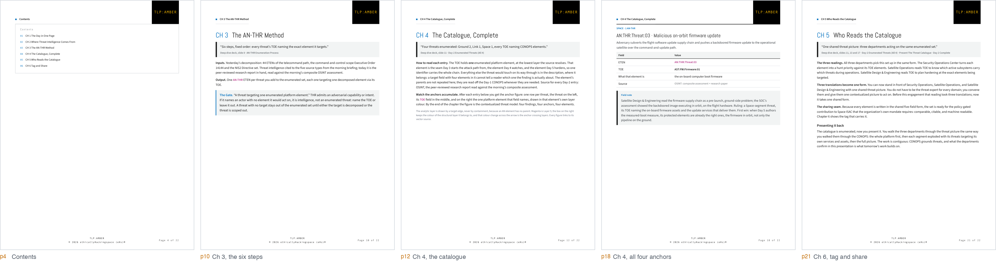
The workbook
TLP:AMBER
The workbook carries all of it, twenty two pages
Five of twenty two pages: contents, the six steps, the catalogue, the anchors.
Module 02 workbook, student edition, pages 4, 10, 12, 18 and 21. Chapter 4 prints all four threats.
Discuss: can you run this function next week from the pages you are leaving with?
Module Two | Contextualized Threat Modeling
Notes:
RUN THIS ONE. Rung: VALUE. Allow 1 minute.
Make them rank, not agree. Take two answers and stop.
ONE SENTENCE, THEN MOVE ON. Five pages, left to right: the contents, chapter 3 with the six steps in fixed order, chapter 4 opening the catalogue on the two Ground threats, chapter 4 closing with all four anchors in one table, chapter 6 with the machine tag and the sharing steps. Twenty one pages. Do not tour it.
The six enumeration steps came off the slides deliberately and live in chapter 3. Say that out loud: the deck argues, the workbook is the method, and they are leaving with the method.
LISTEN FOR: that the deck is the argument and the workbook is the instrument, and the instrument is what gets used after today
If the room does not get there, say it, then move on. Do not argue it.
Register: SP-02, in METEORSTORM-Selling-Points.md.

Slide 25
The mindset
TLP:AMBER
A strike on a named element is a strike already expected
The Pentagon of Pain is the mindset. METEORSTORM is the framework. Transform the three departments, then equip them.
STATE OF THE THREAT CATALOGUE
ADVERSARY IMPACT
Known threats are anchored by METEORSTORM contextualized threat modeling, one enumerated element each, with source and confidence stated and exclusions recorded.
Attackers must vary tools or timing; reused techniques and AI-generated steps land on a named element the defensive cyber operator has already read.
PAIN 2
“The adversary suffers when every strike they imagine is already prepared for.”
The Pentagon of Pain guide, Chapter 5, Pain Index, state 2. Day 2 produced the state in the left column.
Discuss: can you tell a strike from an environmental event on the same record today?
Module Two | Contextualized Threat Modeling
Notes:
THE MINDSET, not the method. Quote verbatim. Say the relationship in order: the Pentagon of Pain is the mindset, METEORSTORM is the framework, transform then equip.
Maya Reyes is the voice and this is her turn. She arrived judging her work by how many feeds she had subscribed to, and she leaves asking what the catalogue costs the actor described in it.
Concrete cost to the adversary: they must now find an element nobody enumerated, which on this platform means going outside the declared scope and being seen doing it.
LISTEN FOR: that anchoring is what turns intelligence into preparation, and an unanchored report prepares nobody
If the room does not get there, say it, then move on. Do not argue it.
Register: SP-01, in METEORSTORM-Selling-Points.md.
IN THE ROOM'S OWN RECORD
Minutes Day 2 minutes, item 07, Why one ordinal carries the whole chain
Mindset Pentagon of Pain, point 02, Master contextualized threat modeling

Slide 26
TLP:AMBER
What we are asking for
Anchor one threat properly
1
Take one threat you already believe in. One, cited, from a source you would defend.
2
Name the single platform element it is directed against, at the lowest layer the source resolves.
3
Write the source on the entry before the entry has a number.
4
Then run the next three functions against that one anchor, and see whether the week holds together.
How would this work where the threat intel team and satellite operations sit with different companies?
Notes:
RUN THIS ONE. Rung: TRANSFER. Allow 2 minutes.
Let the room place itself. Never assert which of the three they outsource.
Close on the ask. Four steps, and the first one needs no new intelligence spend at all. Take two or three answers and stop. If anyone asks about volume, the honest answer is that the first pass is four threats and that is not a limitation being hidden, it is the scope the reference publishes.
LISTEN FOR: that a named target of exploitation is contractable, where describe the affected system is a dispute
If the room does not get there, say it, then move on. Do not argue it.

